Slide 1
Architecture plan
25 September to 31 October: getting to M1, then M2, the design we build against, and what I will do for the team
Muk Chunpongtong · September 2026
Notes:
TIME 0:20
SAY: Main points:
- What I can and will do this month as architect and as Capability Capsule owner
- Short: role, target, the design you will edit next week, my weeks, three experiments

Slide 2
ROLE
Two jobs this month, and why they belong together
Architect: I lead the overall design. It is code-facing: the modules, their interfaces, where each plugs into openJiuwen, and the rules every change is reviewed against
Not the PRD. Ramika's PRD sets the boundaries of M1 and M2: what is in, what is out, and what we must demonstrate. I design the inside: how M1 is structured, and what is possible within those boundaries
Capability Capsule owner. The schema every capability declares, the gate that admits it, and the contract, provider and evaluator that use it
Why together: capsules run in every stage, from intent compilation to dispatch, and CC has to serve verification (a target for every check, Bindings to trace failures) and RSI (lineage, tests by id, observed runs). To own it I already have to know what each component needs
I also write code. A design is only proven when it is built
Roles as agreed for 25 September to 31 October
2
Notes:
TIME 1:00
SAY: Main points:
- Architect means the design, not the requirements: PRD is what and why, design is how and where
- CC was the right way in: it sits where verification and RSI meet, so I had to learn both
- I keep writing code: the schema, gate, contract, provider and evaluator
Supplemental points:
- Last time: all 6 spec bugs we found surfaced where code met the spec

Slide 3
TEAM
Who does what, from now to 31 October
 | Role this month | Component | Main work in M1 and M2 | What the design gives them
Muk | architect; also codes | Capability Capsule | schema v2.11, gate, semantic contract, Symphony provider, evaluator, seed Declarations | the one design doc, kept consistent
Xiaoyang | primary coder | routing | store, intake and stages, runner, dispatch, observability; the models for M1's model capsules | frozen interfaces, so modules can be built in parallel; prompt design reviews
Ramika | PRD | verification | the boundaries of M1 and M2, and their acceptance criteria; the acceptance gates' checks and the step gate, then the node gate | a trace from each requirement to a module and a test
Saurav | blue team (蓝军): attacks our work | RSI | drills on M1 and on M2; checks that the records RSI will read are there | the failure table as a starting attack list; each finding gets a type, a test and an owner
Everyone keeps their component, and everyone can code. Xiaoyang writes the most
Project roles as agreed; component owners unchanged; module split is a proposal for next week
3
Notes:
TIME 1:00
SAY: Main points:
- Four roles for this month, on top of the components we each already own
- Blue team in the Chinese sense: 蓝军 attacks, we are the red side
- The module split is my proposal; we settle it next week
Supplemental points:
- Routing is live from M1: four capsules in M1 call a model

Slide 4
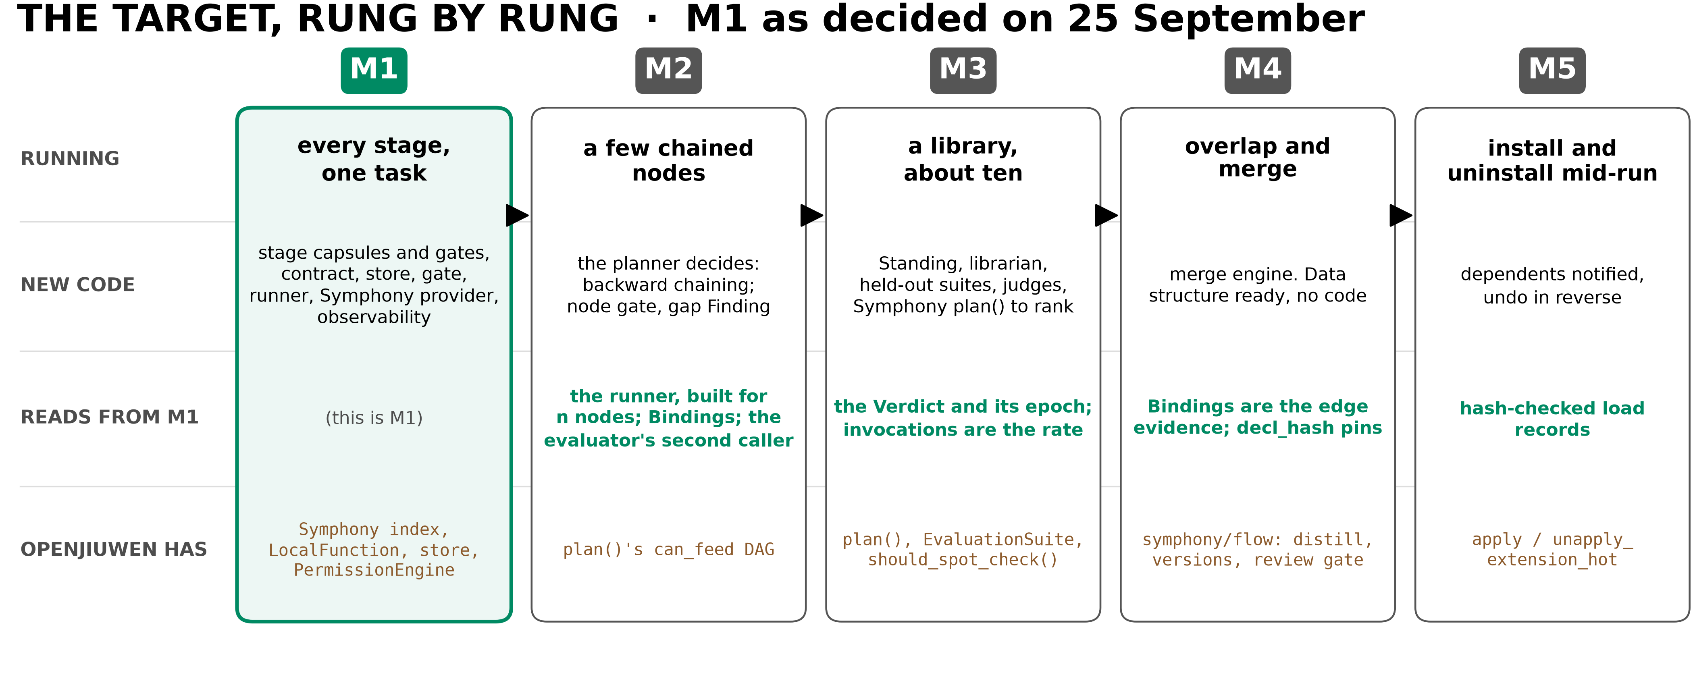
TARGET
Where I am steering us: M1, then M2
This month is M1 and M2. M1 runs every stage with capsules and gates, and Symphony indexes from day one. M3 to M5 are designed in, not built
Milestone ladder (tundle obby, Milestone Ladder); M1 as in obby Directives, 25 September
4
Notes:
TIME 0:45
SAY: Main points:
- Same ladder as layer 2. Each rung reads what M1 writes
- Changed since layer 2: M1 runs capsules in every stage and Symphony is in M1; what M1 keeps trivial is planning, dispatch and the library. The ladder is redrawn to match
- I do not expect M3 this month. What we owe M3 is to not block it

Slide 5
TARGET
Inside the boundaries: how I would structure M1 and M2
 | M1: one task | M2: a few chained nodes
The demo | 'How many spaces are in a b c?' goes through every stage and is answered 2 by count_spaces | 'How many spaces are in report.txt?' answered through parse_txt, then count_spaces
Capsules | compile_intent, review_fidelity, compile_requirement, review_requirement, count_spaces: a fixed set, no library | adds parse_txt
Gates | decide_acceptance, contract acceptance, the step gate | adds a node gate per node
Kept trivial | planning (a pass-through), dispatch (one node), the library (a fixed set) | the planner starts deciding: backward chaining over declared ports
Must also hold | a rejected intent goes back to the human; a changed code file is refused; every capsule call is observed | a node gate checks each output; when nothing fits, a gap Finding, never a guess
The PRD sets the boundaries; I design what fits inside them. Capsules in every stage, chained with gates; planning, dispatch and the library kept trivial
capsule-openjiuwen/team/M1-DESIGN.md, draft 1, section 1
5
Notes:
TIME 0:50
SAY: Main points:
- The PRD decides the boundaries; this is my proposal for what sits inside them, and it moves if the PRD moves
- count_spaces is trivial on purpose: every failure we see is ours, not the capability's
- The stages are not simplified: intent and requirement compilation really run, with capsules and gates
Supplemental points:
- The two requirement-compilation capsule names are proposals

Slide 6
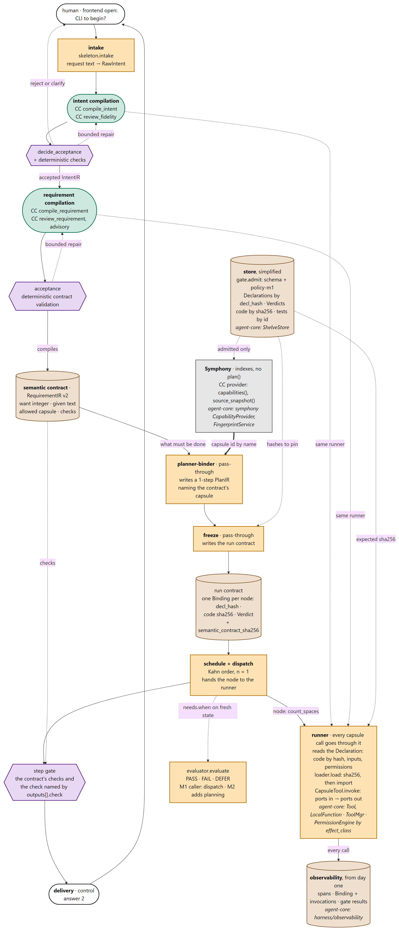
THE DESIGN
The M1 design I lead, as you will edit it
Now switching to the shared file, team/M1-DESIGN.md
The stages, top to bottom: intake, intent compilation, requirement compilation, the semantic contract, planner-binder, freeze, schedule and dispatch, delivery
Four things to look for:
the semantic contract says what must be done, and drives the planner-binder and the step gate
the planner-binder and freeze are pass-throughs: no decisions in M1
the runner makes every capsule call: hash check, ports, permission, Binding
Symphony indexes our capsules; observability records every call
Draft 1. I keep it consistent and merge your edits; next week we all read it and edit it
capsule-openjiuwen/team/M1-DESIGN.md, draft 1, section 2
6
Notes:
TIME 2:30
SAY: Main points:
- Cut to the Markdown here and walk the ten steps from the file, not the slide
- Gates decide, capsules assess or produce: acceptance, planner-binder, freeze and delivery are never capsules
- Ask everyone to read section 3 (owners) and section 8 (decisions) before next week
Supplemental points:
- The detailed M1 map is the big-picture page; the Markdown uses the same names and renders on GitHub or Gitee
- The file also has M2's diagram, the records, the review rules and the failure table

Slide 7
THE DESIGN
The seams I will freeze, and where they plug in
Module | Does | Plugs into agent-core | Owner
store, gate | admit a Declaration; keep it, its code and tests by hash | the KV stores (ShelveStore) | Xiaoyang · Muk; Muk · Ramika
provider | feed admitted capsules to Symphony's index | Symphony's CapabilityProvider: the first concrete one | Muk · Xiaoyang
intake, stages | intent and requirement compilation: capsules, acceptance gates, bounded repair | model calls through the runner | Xiaoyang · Muk
contract | RequirementIR v2 and its deterministic validation | none | Muk · Ramika
planner-binder, freeze | pass-throughs: a one-step plan, then the run contract | Symphony's index, id by name | Muk · Xiaoyang
evaluator | needs.when → PASS, FAIL or DEFER | none | Muk
dispatch, runner | Kahn order; every capsule call: hash check, ports, permission | Tool, LocalFunction, ToolMgr; wraps invoke as the tracer does; permission engine | Xiaoyang · Muk
observe | spans, Bindings, gate results, from day one | harness observability; the KV stores | Xiaoyang
I freeze these interfaces first and review every pull request against them. One extension package; nothing in agent-core is edited
agent-core e23806c1, read in source; capsule-openjiuwen/team/M1-DESIGN.md, draft 1, section 3. Owners are proposals: writer · reviewer
7
Notes:
TIME 1:00
SAY: Main points:
- This is the table that lets us work in parallel: the interfaces are frozen first
- Our provider is the first concrete CapabilityProvider in agent-core
- Workflow ToolComponent calls skip rails today, so the runner guards the tool itself
Supplemental points:
- Open: Symphony's graph accepts only skills, subagents and agents, so count_spaces, a tool, can be indexed but not graphed
- Set ToolCard.id explicitly: the default is a uuid

Slide 8
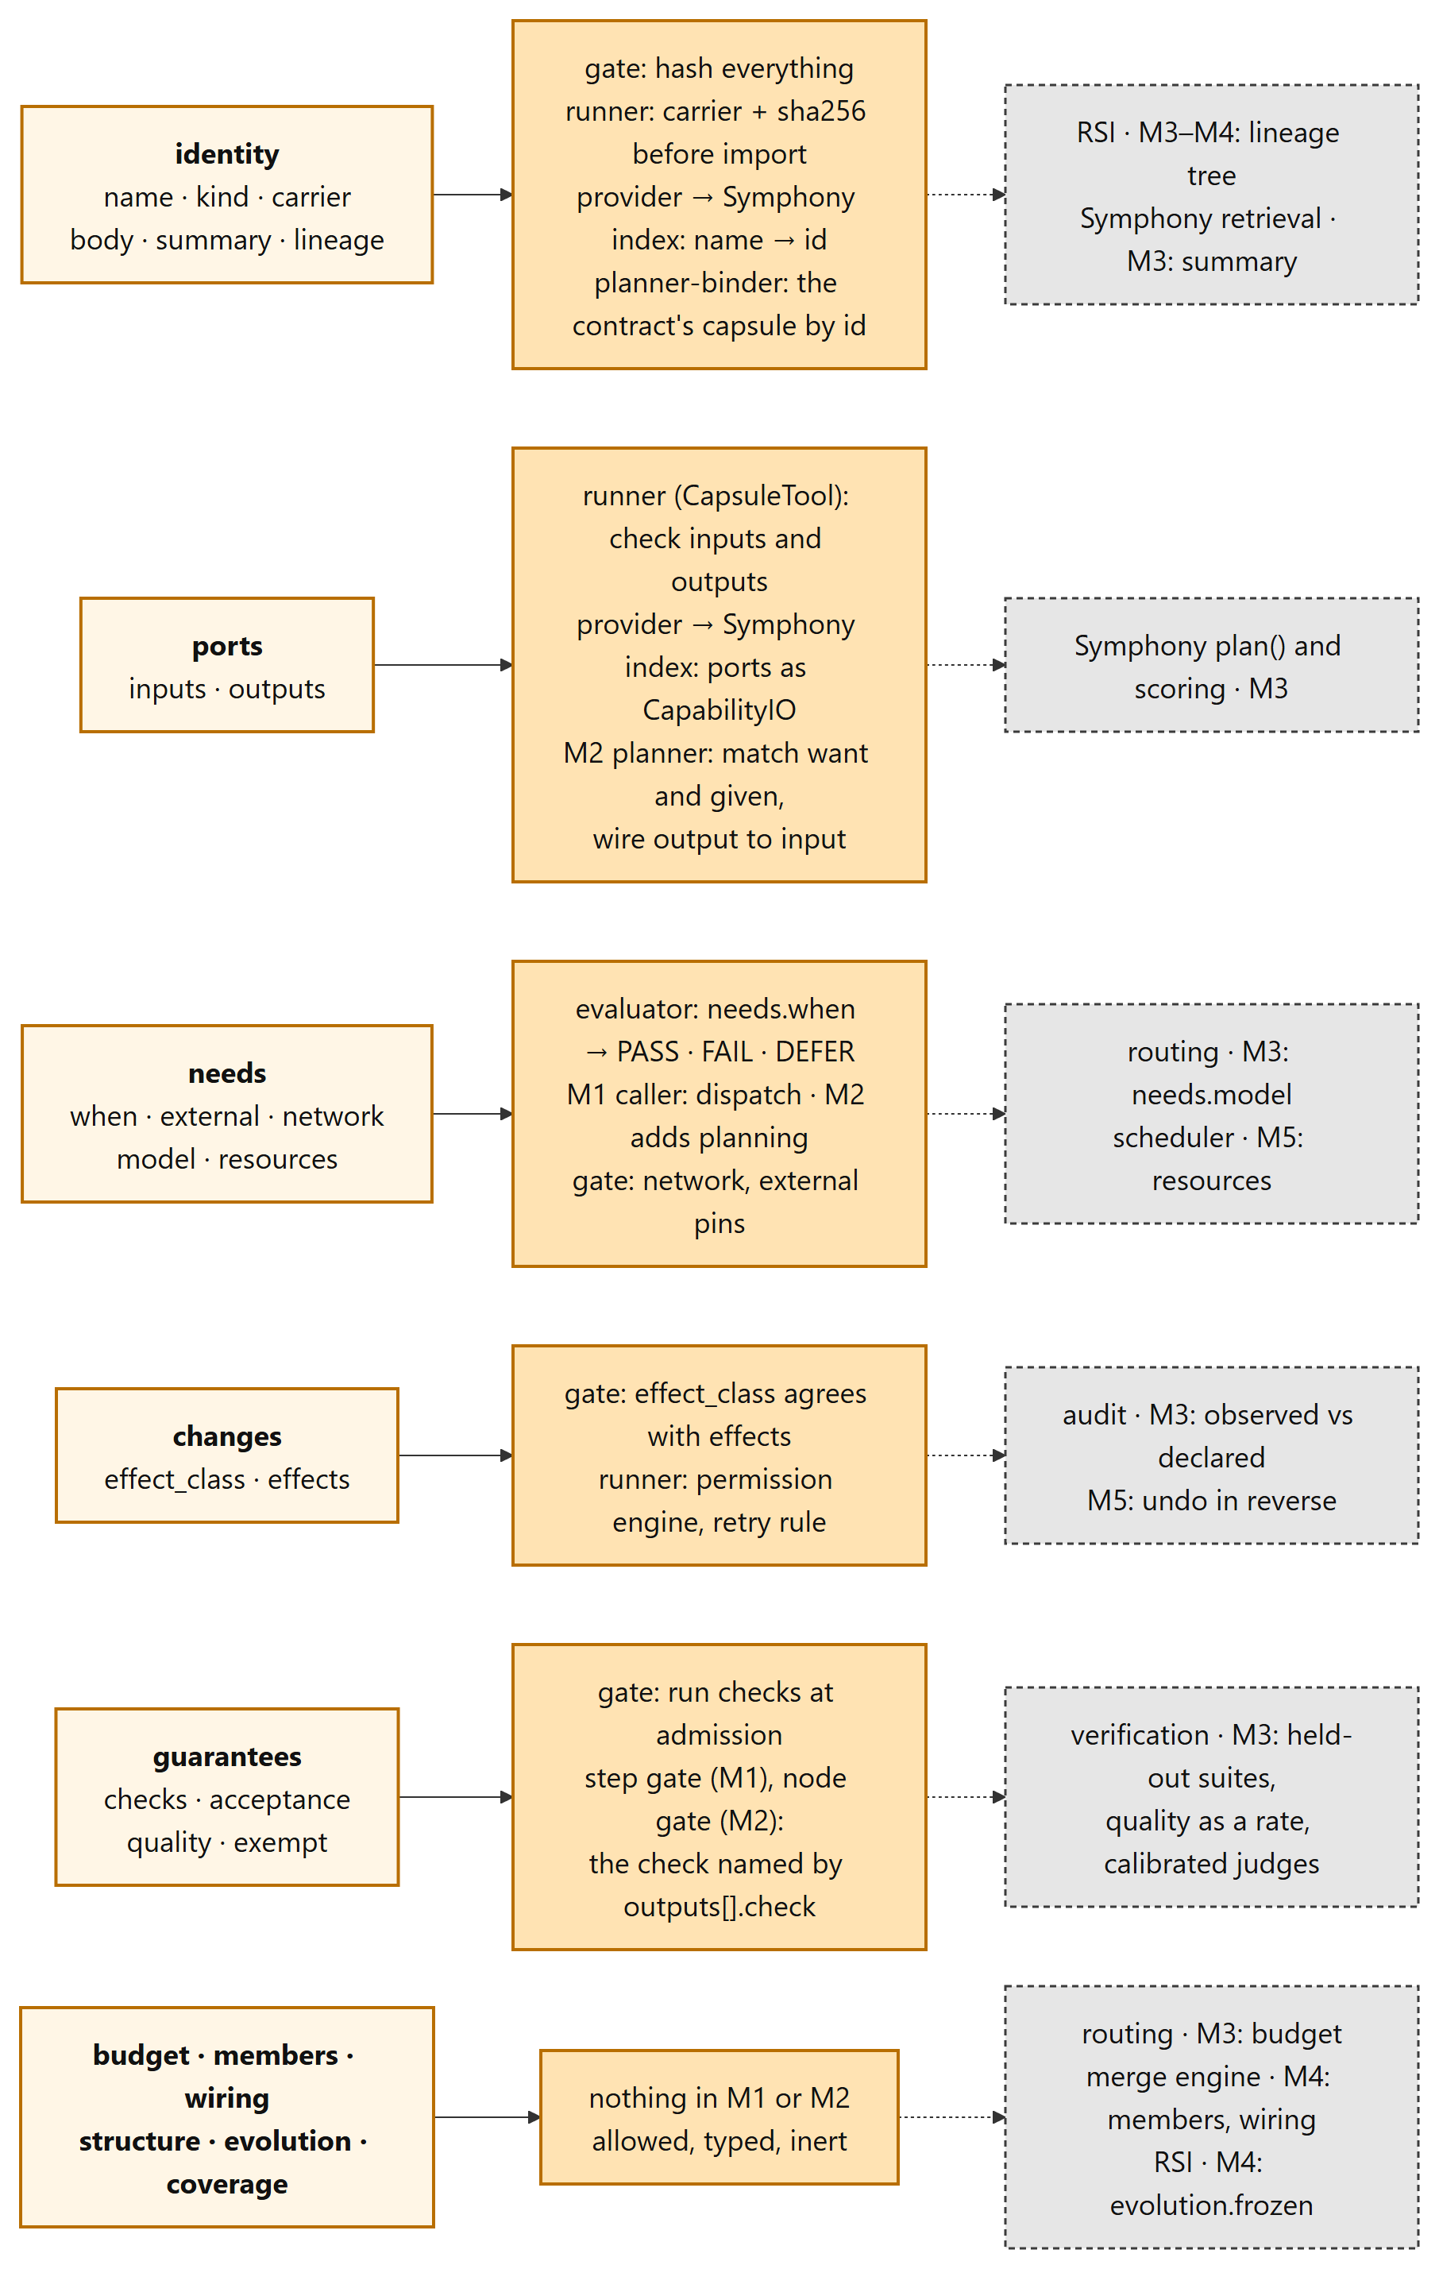
THE SCHEMA
The schema I own, explained
team/SCHEMA-EXPLAINED.md. I own the schema and merge changes; everyone can propose edits
Every field: what it is, why it exists, who writes it, who reads it, and from which milestone. count_spaces is shown whole, and it passes the M1 gate
The diagram: each section, what our M1 and M2 code does with it, and who reads it later
The JSON is what the gate enforces; the page explains it
A field-by-field audit found the JSON and the text disagree: 8 mismatches in fields M1 requires, 16 more elsewhere. WP0 fixes the M1 ones in week 1; the JSON wins until then
capsule-openjiuwen/team/SCHEMA-EXPLAINED.md, draft 1; normative: capsule.schema.json, policy-m1.json
8
Notes:
TIME 1:15
SAY: Main points:
- Same rules as the design: edit through pull requests, questions inline
- Section 7 says what each of your components reads and writes
- The mismatches are the same kind of bug we found after 23 September: the text says one thing, the JSON another
- The JSON refuses unknown fields, so a Declaration written to the text can be rejected
Supplemental points:
- M1 examples: type or artifact_type, check or check_id, and the shape of a precondition
- Also one inside the JSON itself: judge in one field, judged in another

Slide 9
MY WORK
What I will do for M1
Week | As architect | As CC owner (and code) | Done when
1 · 28 Sep | walk the team through both docs; merge edits; freeze interfaces and owners; settle the open decisions | WP0 schema fixes; the five seed Declarations; the RequirementIR v2 contract schema | interfaces v1 agreed; count_spaces and the contract schema written
2 · 5 Oct | review store, gate, runner and dispatch pull requests; trace the PRD to modules and tests with Ramika | gate (with the effect-class rule); provider into Symphony; evaluator; experiment 1, parity | count_spaces admitted, indexed, and run from a hardwritten plan
3 · 12 Oct | integrate the stages end to end; first blue-team drill with Saurav | the stage capsules' Declarations; contract validation and gate checks with Ramika; experiment 1, tamper | M1: a b c answered through every stage, every call observed, a changed file refused
M1 is wider than layer 2 planned: four model capsules, two acceptance gates and a provider. Week 4 is the buffer if it slips
Weeks are estimates, re-planned for the M1 of 25 September: a few capsules, a few gates, Symphony
9
Notes:
TIME 1:00
SAY: Main points:
- Three weeks to M1, with week 4 as the buffer
- Week 1 is mostly reading and agreeing: the cheapest time to change the design
- Review rules from day one: resolve capsules only through Symphony, load only through the runner, address by hash, never overwrite a version

Slide 10
MY WORK
What I will do for M2, and the slack before 31 October
Week | As architect | As CC owner (and code) | Done when
4 · 19 Oct | M2 changes merged into the design; node gate designed with Ramika; gap Finding format reviewed with Saurav for RSI | the planner starts deciding: backward chaining, needs.when at planning; the parse_txt seed | a two-node plan is built from 'spaces in report.txt'
5 · 26 Oct | second blue-team drill, on M2; a note on what M3 needs from verification, RSI and routing | authoring guide v1 from experiment 2 | M2: report.txt answered through two nodes, each output gated
If M1 slips into week 4, M2 narrows to the chain and the node gate. The M3 note does not wait
Weeks are estimates
10
Notes:
TIME 0:50
SAY: Main points:
- M2 is the first time the planner decides; the evaluator gets its second caller
- The M3 note is the handover: what each of your components must be ready to read

Slide 11
MY WORK
Getting to M2: the planner, and the work before it
Work | What it takes | Who | Settle by
The contract | add typed want and given, and the set of allowed capsules, to RequirementIR | Muk · Ramika | week 2, during M1
Types | one type vocabulary with an owner; reuse Symphony's type-compatibility check | Muk | week 2
Schema fixes | one name for a port's type; a field for the state a precondition reads | Muk (WP0) | week 1
The planner | hard filter, then backward chaining over declared ports, with a depth limit and a cycle check; two fits is an error; preconditions through the same evaluator; output in Symphony's plan shape | Muk · Xiaoyang | week 4
Freeze and dispatch | one Binding per node with its edges; outputs wired to inputs by type | Xiaoyang | week 4
Node gate | who writes each part: the capsule's own check, and the step's acceptance | Ramika | week 4
Gap Finding | the fields RSI will read, agreed before M2 writes any | Saurav | week 3
M2's boundaries | the longest chain allowed; what happens when two chains fit or the request is ambiguous | Ramika (PRD) | week 3
Chain by our declared ports, in code. Symphony's graph and the upstream PR for tool nodes wait for M3
Design, from layer 2 (planner-binder), the Milestone Ladder and the schema audit. Owners are proposals
11
Notes:
TIME 1:00
SAY: Main points:
- M2 is the planner's first real job: it stops passing through and builds a short chain
- Four things must be settled during M1, or M2 means migrating records: the contract's want and given, the type vocabulary, the precondition state field, the gap Finding
- No model and no scoring in M2; two fits is an error, not a guess
Supplemental points:
- Symphony already has a type-compatibility check we can reuse
- Why not Symphony's graph yet: it takes only skills, and a model confirms each edge

Slide 12
EXPERIMENTS
Three experiments I will run
 | Question | How | What counts
1 · Parity and tamper (weeks 2 and 3) | Can two callers of a precondition disagree? Does changed code ever run? | M1 has one live caller (dispatch), so the evaluator is tested directly for both contexts before M2 adds planning: every seed precondition against present, absent, unknown and stale state. Then change a byte, add or swap a file, or edit a prompt after admission | 100% agreement, and unknown never passes; every tamper refused, and no false refusals
2 · Authoring cost (weeks 1 to 5) | Can an author afford M1's ten required fields? | log minutes, fields and gate rejections for all five M1 Declarations, tool and model; one teammate writes one from the guide alone | the fields that cost most; keep or relax each in the M1 policy; the authoring guide v1
3 · Blue-team drills (weeks 3 and 5) | What does M1, then M2, let through? | Saurav runs the failure table, including prompt injection into intent compilation, plus his own | attacks tried, caught, where, and missed; each miss becomes a type, a test and an owner
Known gap, stated up front: an effect inside a tool is not observed in M1 or M2
Design. Seam contract tests against the agent-core pin are deferred until after M2
12
Notes:
TIME 1:15
SAY: Main points:
- Each of these would be a major problem if we found it late
- Parity: in M1 only dispatch calls the evaluator; M2 adds planning, so we prove parity before it matters
- Authoring cost is the adoption risk: every required field is work for every author, and M1 has model capsules too
- Contract tests against agent-core wait: upstream can break us whatever we prepare
Supplemental points:
- Drills are logged in the design doc's failure table, so the table grows with what we learn

Slide 13
NEXT WEEK
Next week, and what I need from each of you
Who | Please, by the end of next week
Everyone | read M1-DESIGN.md and SCHEMA-EXPLAINED.md; edit or question anything inline
Xiaoyang | confirm the module split and the interfaces you will build against
Ramika | the M1 and M2 boundaries and acceptance criteria in the PRD, so I can design inside them
Saurav | your first attacks on the design, before any code exists
Decisions, with defaults: Symphony indexes tool capsules without graphing them, or M1's capsules become skills · the IR schemas and their owners · a CLI frontend · carrier as the field name · pin agent-core e23806c1 · which repository the team shares
capsule-openjiuwen/team/M1-DESIGN.md, draft 1, section 8
13
Notes:
TIME 1:00
SAY: Main points:
- Everything here has a default, so nothing blocks week 1
- The Symphony question is real: its graph takes only skills, subagents and agents
- The one I cannot default: which repository we share the docs and code in

